Slide 1

FED
WE
E
K
Hypertext Markup Language
Structural HTML Elements
Phrasing HTML Elements
Table HTML Elements
Front End Development
Diploma in CSF
Year 1 (2021/22), Semester 2
1

Slide 2
Remote Learning Instructions
Step 1
Read the given slides.
Details in slide 2-10
Attempt the Exercise
Details in slide 8
Step 2
Perform highlighted activities in Activities slide
Details in slide 11
Optional items if only your time permits
Step 3
Complete and Submit Tasks given
Details in slide 12

Slide 3
HTML Basics
Basic syntax for creating an HTML document and the details that can be included in the <head> element.
HTML elements that are used to organize contents and create a web page using these semantic elements.
Semantic meaning to HTML content.
This will ultimately make your document more maintainable, and when it comes time to write the CSS, you’ll be glad you did.

Slide 4
HTML Basics…(Cont)
How to use the table element to present tabular data.
A table consists of rows that are represented by the table row <tr> element. Each row contains a collection of table cells <td> and/or table head cell <th> elements. Columns are not explicitly defined but are inferred based on the existence of <td> or <th> elements HTML elements that are used to organize contents and create a web page using these semantic elements.

Slide 5
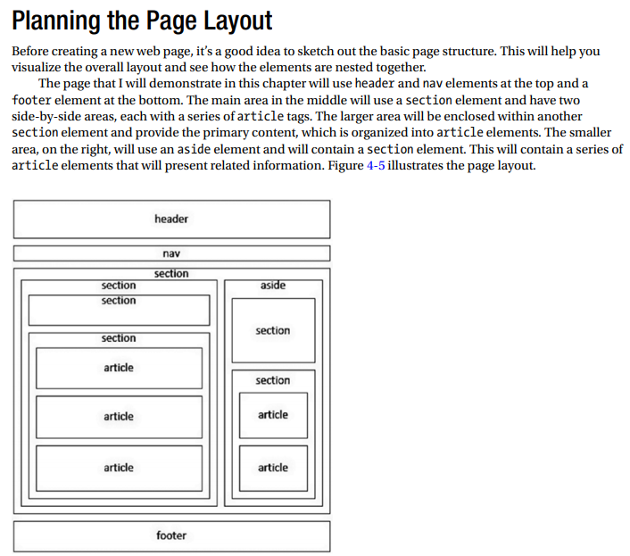
Planning the Page Layout

Slide 6
Topics
Hypertext Markup Language
HTML Document
HTML Elements
Attributes
Miscellaneous Structure Rules
<head> Element and Elements Within
Structural HTML Elements
Sectioning Content
Grouping Elements
Listing Elements
Inline Frames

Slide 7
Topics (Cont)
Phrasing HTML Elements
Highlighting Text
Other Semantic Phrasing
Edits, Quoting, Span
Adding Carriage Return
Table HTML Elements
Simple Table
Column and Row Headings
Column Groups
Table heading and Footer
Spanning Cells

Slide 8
Exercise
Attempt “FED 2021-10 Week 1 Exercise.docx”
NB: Files can be downloaded from MEL
Tasks | Videos
Create New Project
Add Folder And Images
HTML Semantics

Slide 9
HTML Table
Video on HTML Table (reference for worksheet)
Tasks | Videos
HTML Table Creation
HTML Table – Rowspan / Colspan
NB: Files can be downloaded from MEL

Slide 10

Reference
Learning Web Design
A Beginner’s Guide to HTML, CSS, JavaScript and Web Graphics
Jennifer Niederst Robbins
Available to download from NP library:
https://ebookcentral.proquest.com/lib/np/detail.action?docID=5412749&query=Learning+Web+Design
Companion website for the book:
learningwebdesign.com

Slide 11
Activities
Read Part I (Optional)– Getting Started (Chapters 1-3) from the textbook.
Read Part II – HTML For Structure (Chapters 4, 5, 6, 8) from the textbook.
Additional Reading Material - Structural HTML Elements.pdf
Watch the following video clip (Optional)
HTML5: Structure, Syntax, and Semantics
https://www.linkedin.com/learning/html5-structure-syntax-and-semantics/what-are-web-semantics?u=42538748
You need to sign in with your NP email address to view the full video.
Note: This is a recommended activity. You may opt to skip if you have good understanding of how the web works.

Slide 12
Tasks
Complete Week 1 Practical.
Download Week 1 Practical in MEL – “FED 2021-10 Week 1 Worksheet.pdf”
Deadline end of Week 1
Submit the completed practical files in MEL.
Zipped the source files
Name the zipped file in following format:-
FED-Week01-SXXXXXXXX (where SXXXXXXXX is your student id)
Submit the zipped file in the weekly folder’s submission link in MEL
Also, submit the zipped file into FED network folder (\\ictspace.ict.np.edu.sg\FED) under your studentID. This is for backup purpose only. Main submission is still in MEL.
If you have any questions please communicate with your tutor via Microsoft Teams.

